Slide 1
Ethan J. Witt
Portfolio

Slide 2
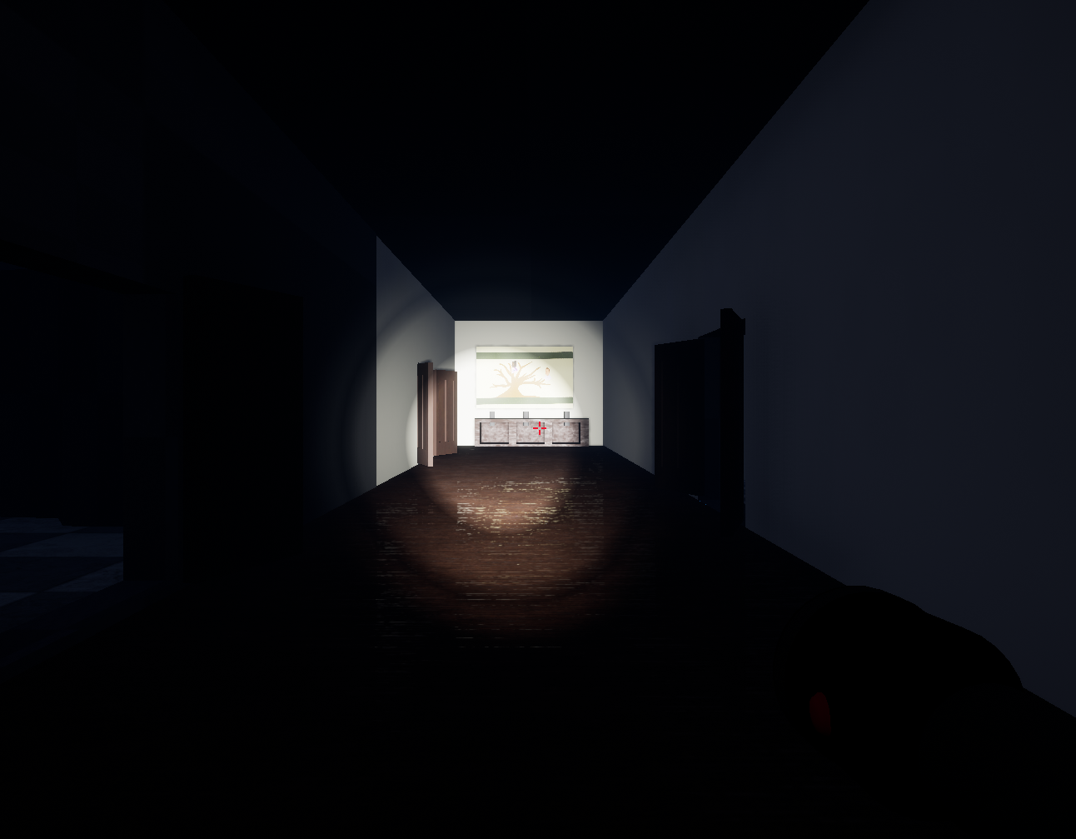
Clueless Murder Palace
(Unreal Engine 4)
Clueless Murder Palace came to be from a Global Game Jam competition (https://globalgamejam.org/2019/games/clueless-murder-palace) where participants are given 48-hours to create a game start to finish. The catch is the participants must create the game based on a theme that is unknown to the participants until the event begins. Our team created Clueless Murder Palace in 2019.
Description: “You are now the proud owner of that old Victorian house on the hill, all its contents, and its otherworldly residents. In order to make this house your home, help the ghosts that abound find peace, by placing objects of importance to them back where they belong, and removing objects that caused their demise. Based loosely on the board game Clue, use visual and audio clues to find the objects without angering the ghosts. Help the likes of General Catsup and Dr. Sauce find eternal peace.”

Slide 3
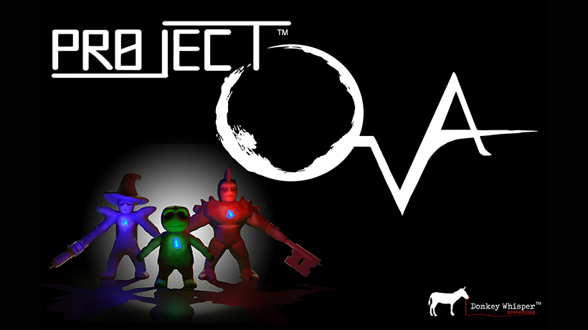
Project OVA
(Unreal Engine 4)
Currently in production by Donkey Whisper Productions
Description:
“You find yourself trapped in the mansion of Doctor Markov Dragunov, the brilliant, if eccentric, scientist. Filled with the products of his unorthodox research, his home would be challenging to navigate even at normal size. As a tiny clay figure, it’s nearly impossible! And it’s not just the mundane challenges of tall furniture and insurmountable staircases that you need to worry about. There are strange and deadly creatures around every corner, but there’s also something else. Someone has left clues, little sticky notes, to help you puzzle your way through these hazards. You may be small and composed almost entirely of clay, but you’re not without resources. On this level, a razor can become an axe blade. A paper-clip and a rubber band can become a bow for toothpick-arrows. In this house-turned-science-lab, there’s no shortage of possibilities as you cobble together weapons and equipment from the “junk” lying around. You might even learn something along the way, if you can find time to explore. Markov appears to have left his own notes and research all over the mansion. Papers, charts, journals, voice recorders, and more all hold information about why you are here, and how you became trapped inside this frail, yet versatile body. Perhaps you can use his notes to improve your own situation by building a better body or constructing useful devices. Perhaps you can even find a way to restore your true body, whatever (or wherever) that may be. You’re going to need every advantage you can get, as you craft, fight, sneak, and puzzle your way through this unorthodox world. Luckily, the creatures aren’t just trying to kill you, some of them appear to be attacking one another. The strange, mutated creatures don’t get along well with their more robotic counterparts. Perhaps you can use this to your advantage, while you struggle to survive and escape this madhouse!”

Slide 4
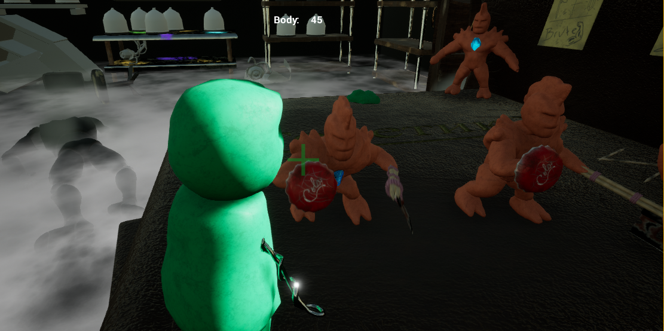
Project OVA
In Project OVA, many of the items in the environment can be used to craft equipment for the player to use. A bottlecap can be a shield, a toothpick can be a spear, ingenuity and creativity are needed in order to escape the mansion and find out what happened.

Slide 5
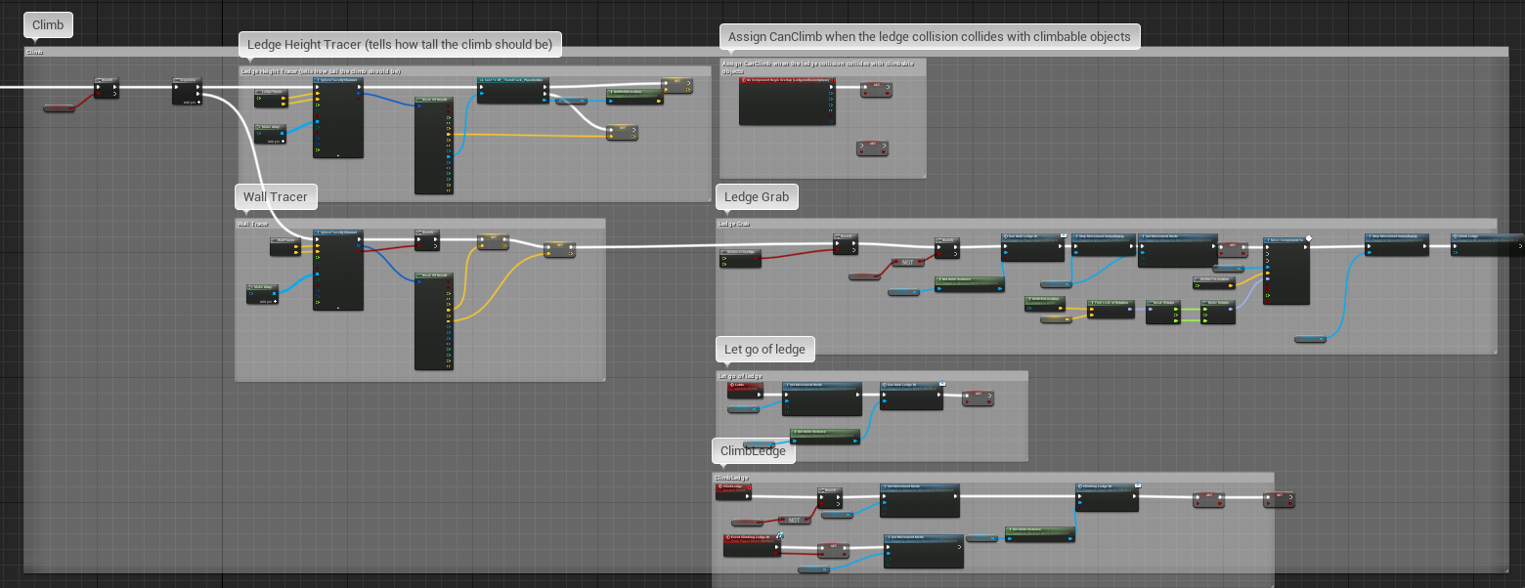
Project OVA
An example of Blueprints I created for Project OVA. This functionality is how the game processes when the character tries to climb up to a ledge.

Slide 6
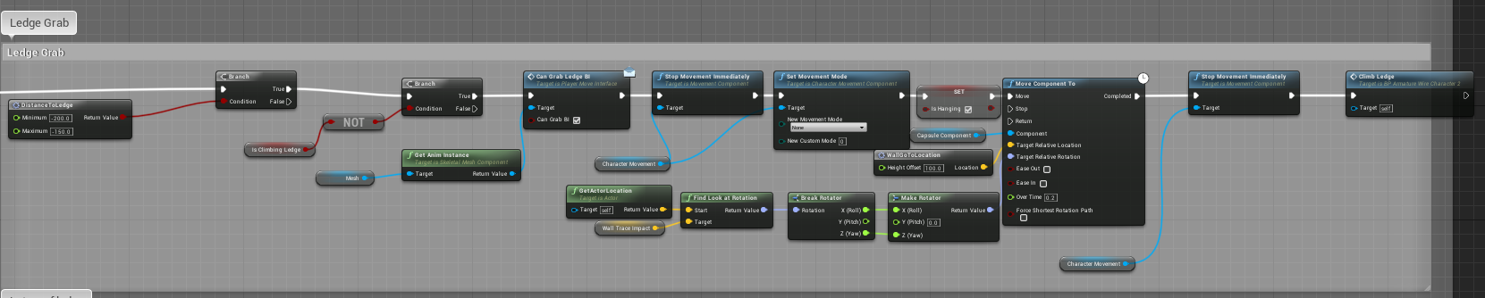
Project OVA
This is a more zoomed in view of some of the functionality for the Ledge Grab function.

Slide 7
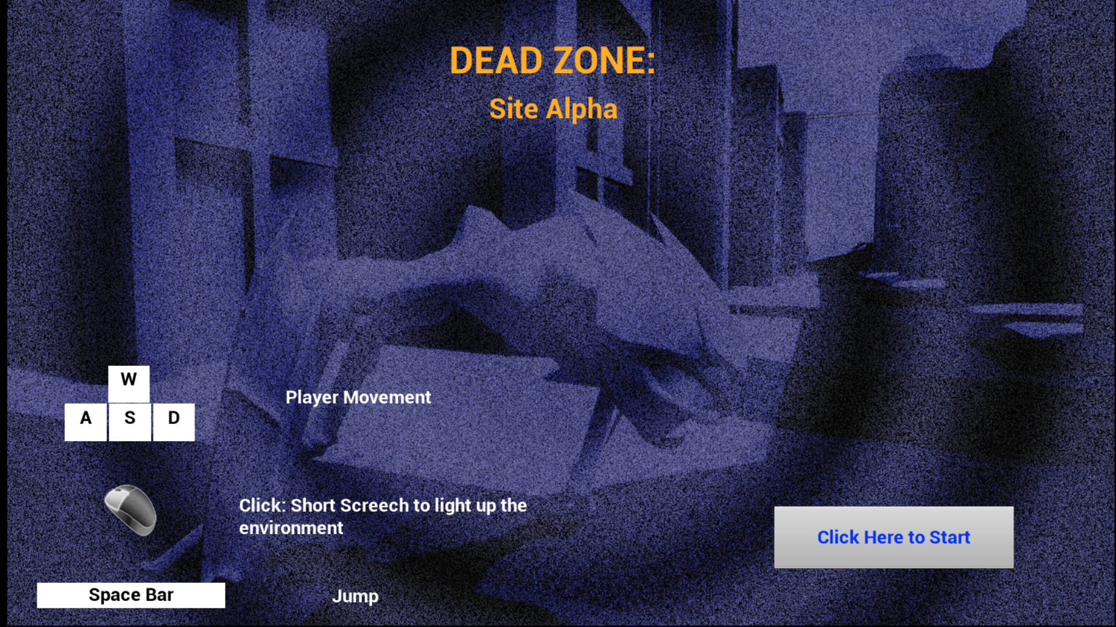
Dead Zone: Site Alpha
(Unreal Engine 4)
Dead Zone: Site Alpha was another Global Game Jam project where the team had 48-hours to create a game. The theme for this “Jam” was “Transmission.” In this case, we interpreted how sonar or echolocation can transmit sound and be interpreted in order to navigate the environment.
Description:
A sci-fi thriller game played from the point of view of an alien creature that uses echolocation to see. The alien species is one of many occupying Earth and is a master of stealth and must navigate an abandoned city and avoid the humans of the Resistance to take out a radio tower that has been broadcasting rebellious messages and information.

Slide 8
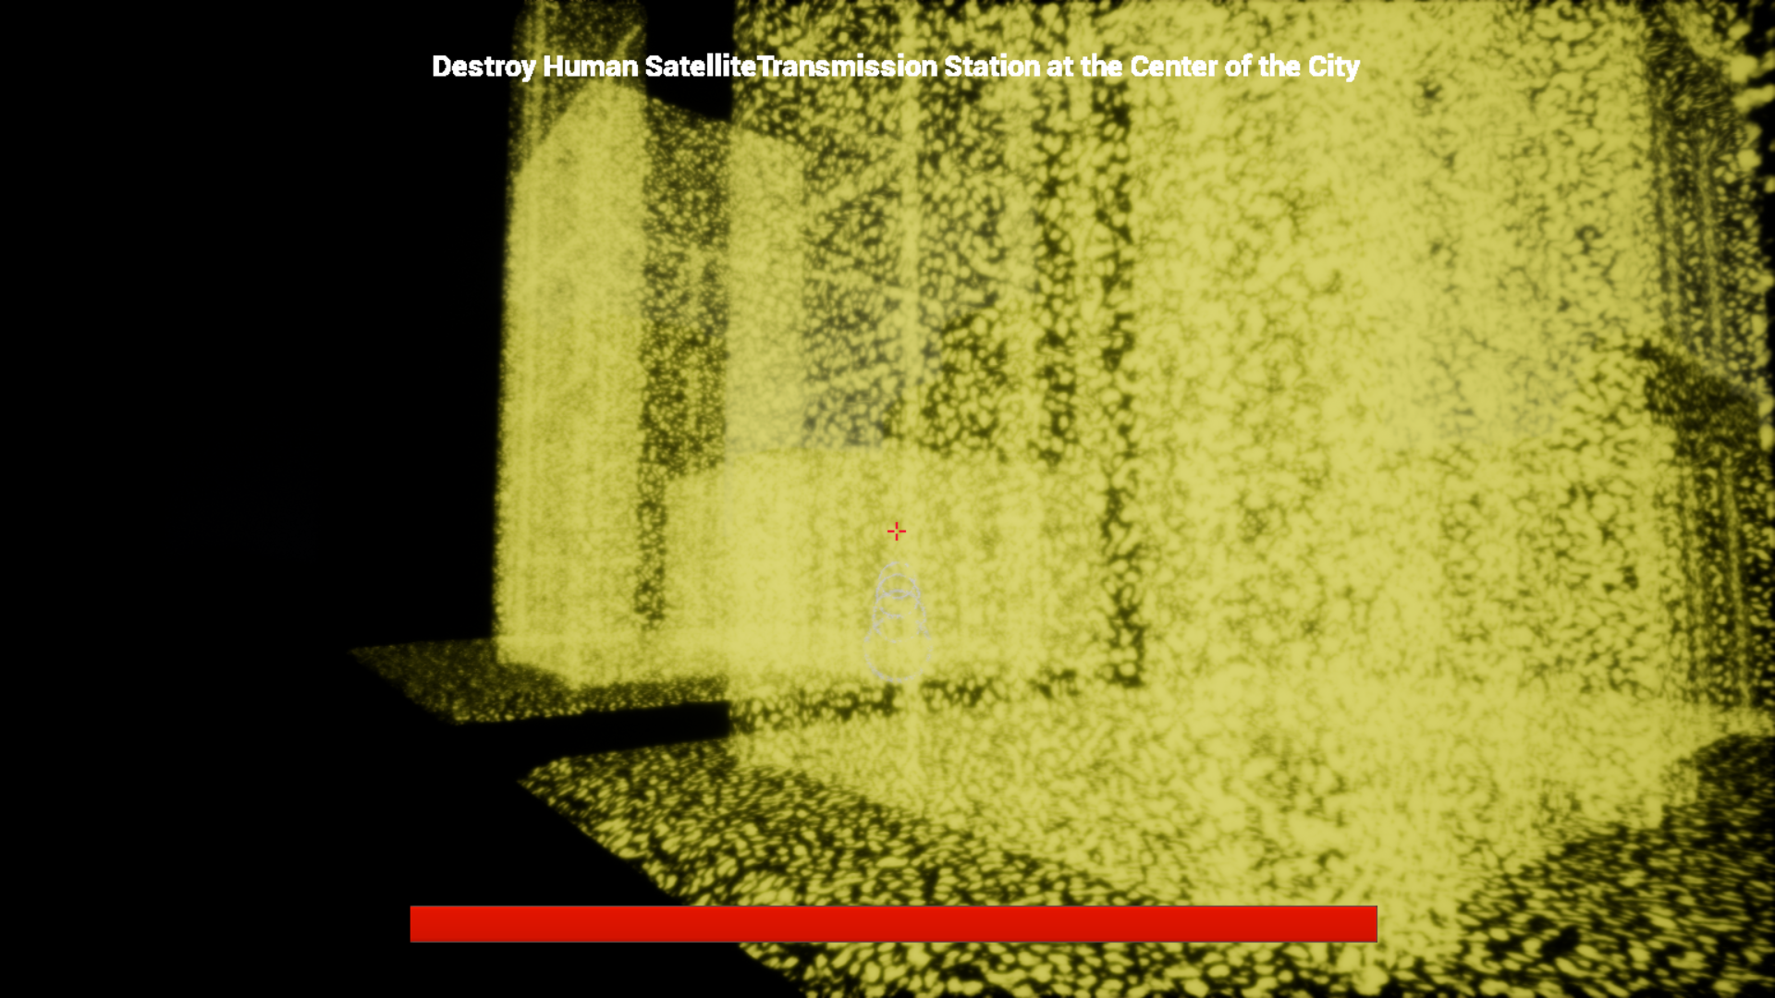
Dead Zone: Site Alpha
In the game, the player would press a button and the character produces a focused sound. Whatever the focused sound hit would illuminate briefly. The player had to navigate a city and avoid enemy patrols.

Slide 9
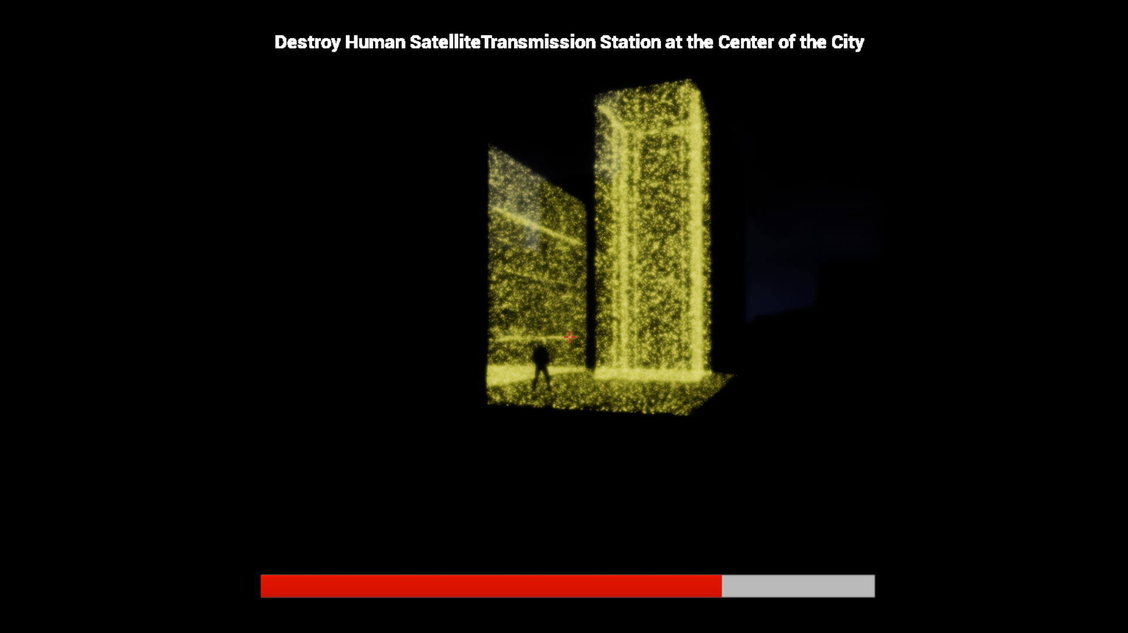
Dead Zone: Site Alpha
This is an example of the player running into an enemy patrol and losing health after being attacked.

